Slide 1
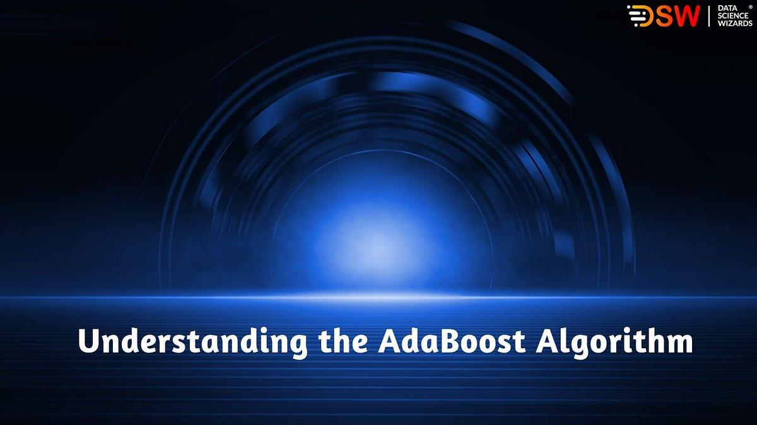
A guide by Chip Heath & Dan Heath

Slide 2

A meta-estimator that begins by fitting a classifier on the original dataset and then fits additional copies of the classifier on the same dataset but where the weights of incorrectly classified instances are adjusted such that subsequent classifiers focus more on difficult cases.

Slide 3


1. Intro
AdaBoost techniques combine many weak machine-learning models to create a powerful classification model for the output.
Unexpected AdaBoost can be used both for classification and regression problems
Simple Boosting algorithms are a set of the low accurate classifier to create a highly accurate classifier.

Slide 4
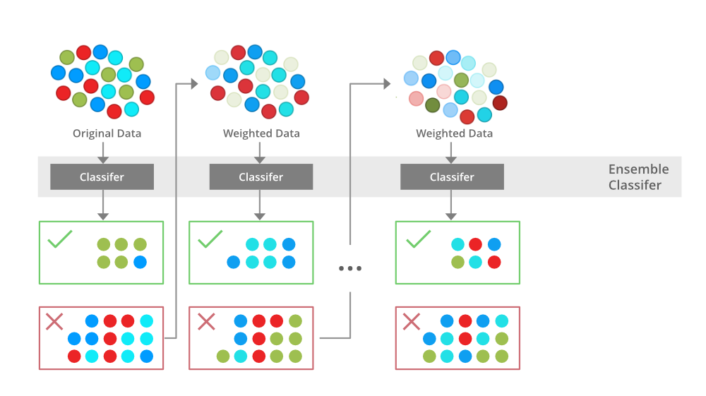
How many languages do you need to know to communicate with the rest of the world?
Tip
In this example, we’re leading off with something unexpected.
While the audience is trying to come up with a number, we’ll surprise them with the next slide.

Slide 5
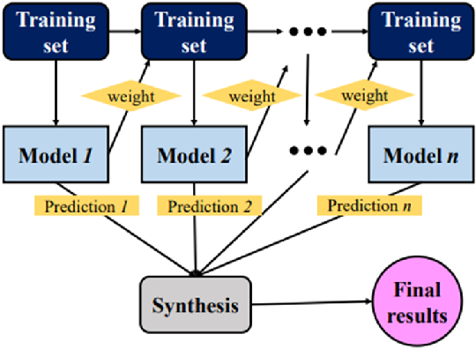

Slide 6
